Slide 1
EMANIO CONTEXT!
www.51pptmoban.com 搜集整理
We will begin in a few minutes
IMPORTANT:
The meeting Telephone number has changed:
►To dial-in call: 646-558-2101
► Your Meeting ID is: 738-816-378
Notes:
clock

Slide 2
Who is EMANIO
LONGEVITY
EXPERIENCE
VISION
TRUSTED
Founded in 1994
Privately held
Established in Scandinavia
Moved to US in 2001
Over 2,000 Installs world-wide
Decades of combined experience
Pioneered Internet-based EDI in 1996
Ease of use
Ease of deployment
Affordable solutions
Scalable Enterprise-grade
Outstanding support
Predictable deployments
Mid-Market Focus
Service focused
Notes:
In Fact, since 1994 EMANIO has focused exclusively on the mid-market with a vision trained on ease of use and automation along with a privately held financial portfolio that means we are only beholden to the needs of our customers – not shareholders.
With over 15 years and 2,000 deployments of experience and a support organization focused on keeping our customers happy, we bring an ideal mix of technology and experience.
Our customers span the range from divisions of large enterprises to some of the best names in the sub-enterprise community.
Companies like UPS, McKee foods, Guittard chocolates, Flowmaster, CH Powell, Kettle foods and hundreds of others rely on EMANIO every day.

Slide 3
Full Service Business Intelligence
ENTERPRISE
MID-MARKET
IBM
Data Integration Capabilities
Dashboarding & Reporting
Predictive Analytics
Extremely expensive
Steep learning curves
EMANIO
Data Integration
Dashboarding & Reporting
Predictive Analytics
Affordable
Focused on Ease of use
FULL SERVICE
SAS, Microstrategy…
Hard to deploy
Enterprise focused
Prohibitively expensive ($300K+)
Steep learning curves
TABLEAU, STERLING, STATSOFT…
Very vertically focused
Solutions don’t scale easily
Difficult integration options
Focused on single-user features
VERTICAL VENDORS
Notes:
EMANIO provides a full service BI offering that includes dashboarding, reporting as well as predictive analytics, letting organizations understand the past and the trends of their data while also having an easy to use yet powerful tool to forecast and predict future behavior through data mining and predictive analytics. In the entire BI space only IBM with their recent acqusition of SPSS provides this breadth of capabilities – at a MUCH higher price.

Slide 4
Core elements of EMANIO BI
We believe a business intelligence platform should provide:
Faster deployments and provide for shorter training times
Easy data mashups and make presentation of data to users easier and more intuitive
Multi-stage security & control mechanism
Dynamic data delivery to off-line users
Predictive capabilities to forecast future events vs. simply understand the past

Slide 5
FOCALPoint™ Architecture
OLD WAY
FOCALPoint™
ONE point of security, data management, configuration & management
Multiple points of security, data management, configuration and maintenance

Slide 6
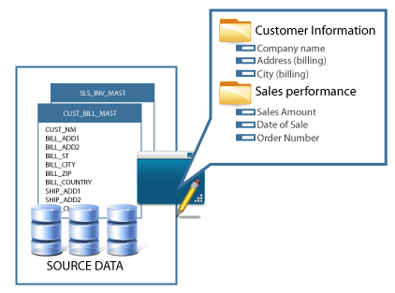
DATAFusion™ Mashup Architecture– Data mashups made easy
DATAFusion™
Manage multiple data sources and provide intuitive, easy to view data presentations to users to lower costs and increase user adoption
Faster deployments through quicker access to production data
Shorter learning curve for users who see comfortable views & names
More precise control over who sees what data

Slide 7
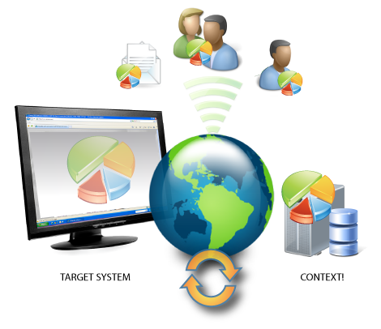
AIRTime™ Technology
AIRTime™
Send reports to users, groups, emails and web services based on time intervals and conditional triggers
Send Information dynamically based on event & time triggers
Share charts & reports with external users dynamically
Access charts & reports through web services

Slide 8
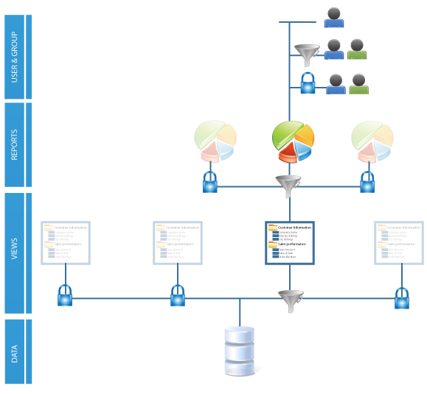
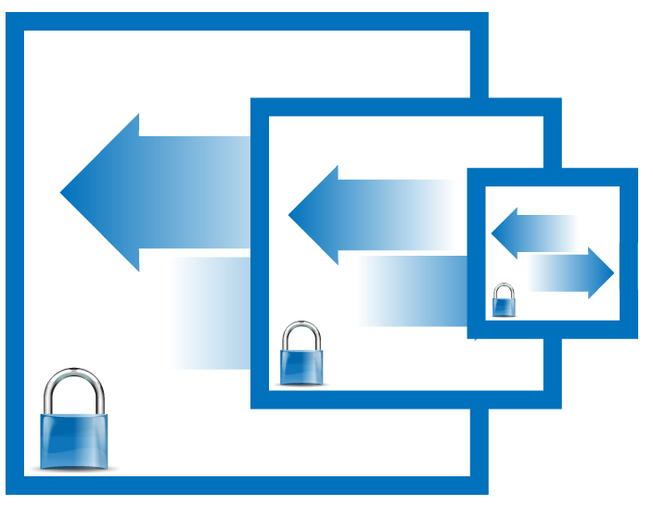
CONTROLStep™ Security & Admin Framework
Provide multiple layers of security & data control to delegate access, authority & admin control
CONTROLStep™
Cascading levels of security and data control
Offload security & data control as necessary
Provide data & report access to users as needed

Slide 9
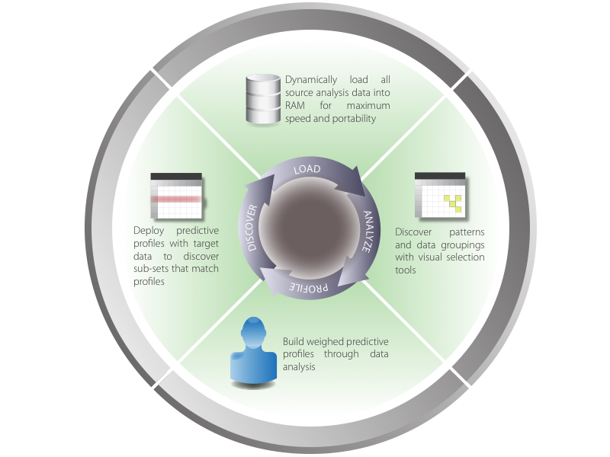
PREDICTIVELogic™ Framework
Provide an easy to use, interactive, powerful means of learning from existing data to model future scenarios
PREDICTIVELogic™
Intuitive easy to use user interface
Fast, in-memory analysis engine
Build predictive profiles of data
Deploy profiles to analyze future scenarios

Slide 10
DEMONSTRATION

Slide 11
The EMANIO Difference
Complete solution focused on integration, communication and intelligence & analytics
Affordable price points that bring BI and data integration to organizations of any size
High performance, enterprise-grade solutions that can scale seamlessly
Focus on support and post-sale customer service that is unmatched in the industry
Notes:
EMANIO provides a better answer. Our solutions are focused on the integration, communication and understanding of data.
Our affordable price points make BI and integration accessible to any sized business and we bring to the table a set of high performance, high-availability solutions

