Slide 1
This study is brought to you courtesy of
www.google.com/think/insights

Slide 2
The Mobile Movement
Understanding Smartphone Users
Google/IPSOS OTX MediaCT
U.S., April 2011

Slide 3
Research Objectives
Gain a deep understanding of smartphone consumer behavior,
specifically with regard to:
DAY
How are
smartphones
used in
daily life?
How do consumers
multi-task
with their
smartphones?
What types of info
are consumers
searching for on
mobile ?
What role do
smartphones play
in decision making
for products & services?
How do
consumers
respond to
mobile ads?
Google Confidential and Proprietary
2

Slide 4
Research Methodology
• In partnership with Ipsos OTX MediaCT, a total of 5,013 US online
adults (18-64 years of age) who identified themselves as using a
smartphone to access the Internet were interviewed.
– A smartphone is defined as “a mobile phone offering advanced
capabilities, often with PC-like functionality or ability to download apps”
• Respondents were asked a variety of questions around: device
usage, mobile search, web and commerce behavior, mobile
advertising
• Interviews were conducted in Q4 2010
Google Confidential and Proprietary
3

Slide 5
Agenda
1
2
3
4
5
General Smartphone Usage
Action-oriented Searchers
Local Information Seekers
Purchase Driven Shoppers
Reaching the Smartphone User
Google Confidential and Proprietary
4

Slide 6
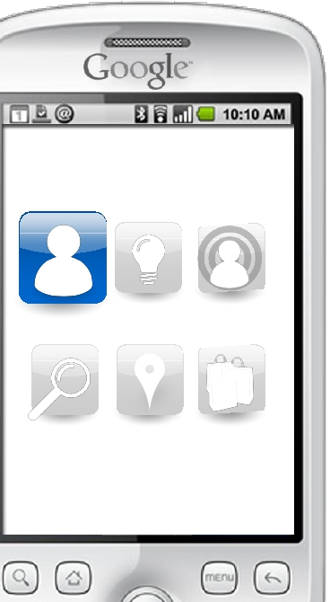
General
Smartphone
Usage
Google Confidential and Proprietary
5

Slide 7
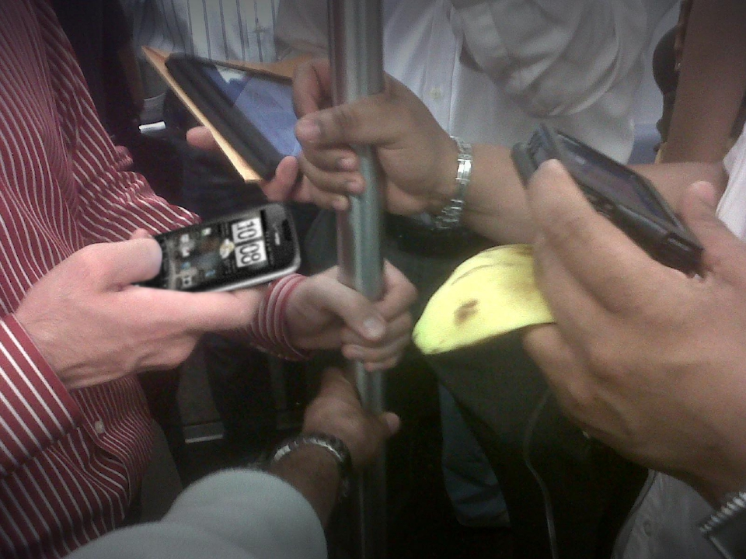
Smartphones Are Embedded Into Daily Life
89%
Use their smartphone
throughout the day
Source: The Mobile Movement Study, Google/Ipsos OTX MediaCT , Apr 2011
Base: Smartphone Users (5013)
Q. Overall, how often do you use your smartphone for anything other than sending or receiving calls? Please think of anytime
you may access the Internet, use apps, text message, etc
Google Confidential and Proprietary
6

Slide 8
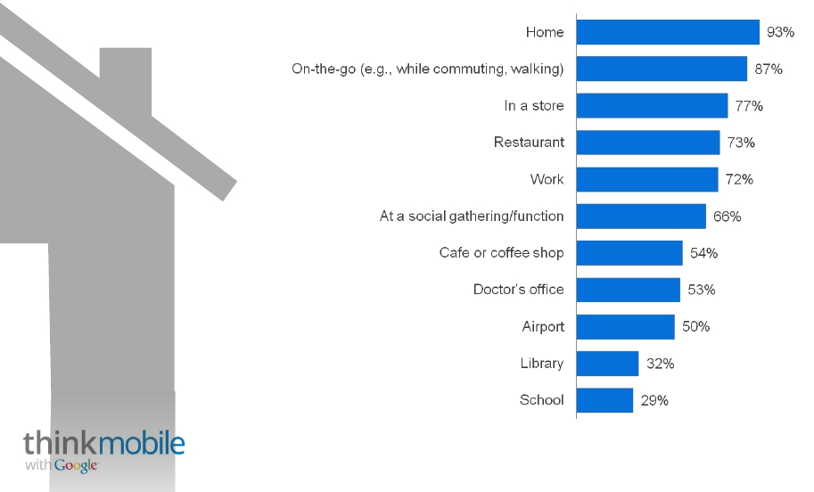
A Consumer’s Always-on Companion
Where Smartphone Is Used
93%
Home
Source: The Mobile Movement Study, Google/Ipsos OTX MediaCT , Apr 2011
Base: Smartphone Users (5013)
Q. Where do you use your smartphone?
Google Confidential and Proprietary
7

Slide 9
Smartphones Serve As Pocket PCs
and Extend Desktop Experience
81%
Smartphone Activities Within Past Week
(Excluding Calls)
Browsed the internet
Used77%
68%
a search engine
48%
Used an App
Watch videos
Source: The Mobile Movement Study, Google/Ipsos OTX MediaCT , Apr 2011
Base: Smartphone Users (5013).
Q. Aside from making or receiving calls, which of the following activities, if any, have you done on your smartphone in the past week?
Google Confidential and Proprietary
8

Slide 10
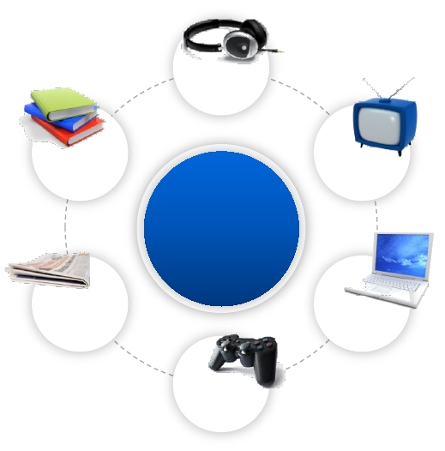
Smartphones Are Used While Consuming
Other Media
Listen to music
44%
Read a book
Watch TV
16%
%
Use smartphone
33%
72
while….
Read news-
paper/magazine
22%
Use internet
29%
Play video games
27%
Source: The Mobile Movement Study, Google/Ipsos OTX MediaCT , Apr 2011
Base: Smartphone Users (5013).
Q. In general, which of the following media-related activities do you do while also using the
Internet on your smartphone?
Google Confidential and Proprietary
9

Slide 11
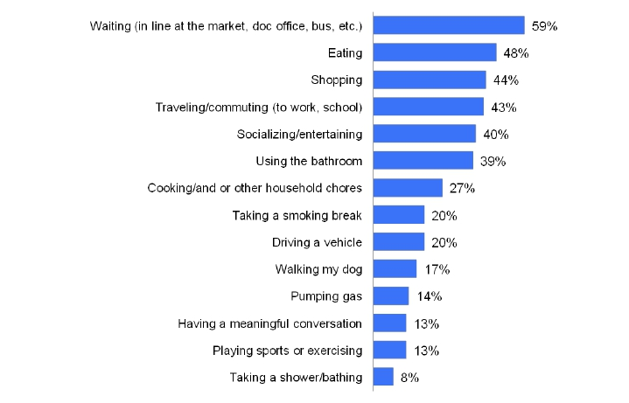
Smartphones Users Multi-task in General
Activities Conducted While Using Internet on Smartphone
59%
Waiting in line
40%
Socializing
39%
Using the bathroom
27%
Cooking
Source: The Mobile Movement Study, Google/Ipsos OTX MediaCT , Apr 2011
Base: Smartphone Users (5013).
Q. Over the past year, which of the following activities do you participate in while also
using the Internet on your smartphone?
Google Confidential and Proprietary
10

Slide 12
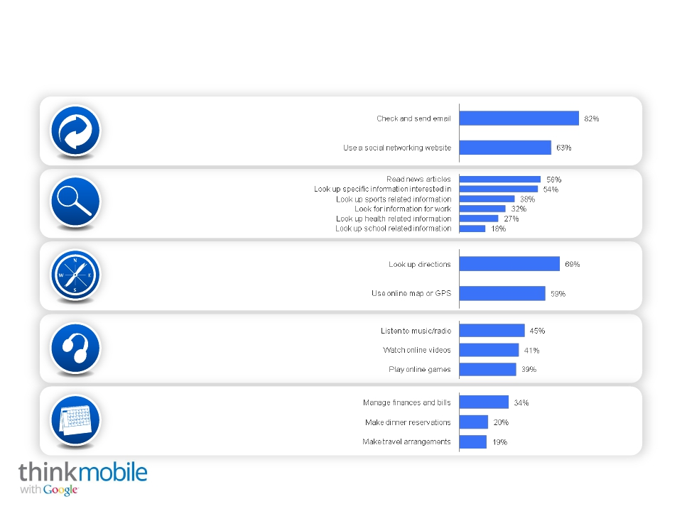
Smartphones Help Us With Our Daily Lives
89% Stay Connected
82%
Research and
Read news
75% Navigate
65% Keep Entertained
45% Manage and Plan
Source: The Mobile Movement Study, Google/Ipsos OTX MediaCT , Apr 2011
Base: Smartphone Users (5013).
Q. Which of the following Internet activities do you use your smartphone for?
Google Confidential and Proprietary
11

Slide 13
What We’re Willing to Give Up to Keep
Our Smartphones
Willing To Exchange For Internet Usage On Smartphone
43%
BEER
36%
CHOCOLATE
34%
SUPERBOWL
26%
HIGH HEELS
20%
CABLE TV
TICKETS
Source: The Mobile Movement Study, Google/Ipsos OTX MediaCT , Apr 2011
Base: Smartphone Users (5013).
Q. Which of the following things would you be willing to give up for an entire month, in exchange
for continuing to use the Internet on your smartphone?
Google Confidential and Proprietary
12

Slide 14
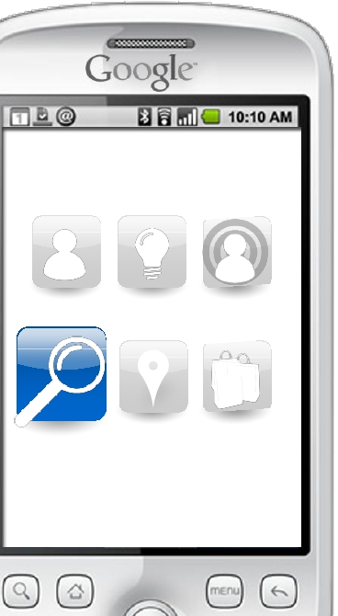
Action-oriented
Searchers
Google Confidential and Proprietary
13

Slide 15
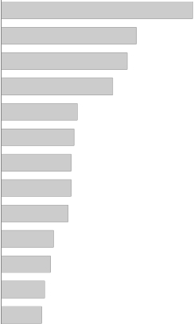
Search is The Most Visited Website
Websites Visited via Smartphone
77%
Search engine websites
Social Networking websites
Retail websites
Video sharing websites
General consumer websites
Brand or manufacturer websites
Review websites, blogs or msg boards
Health information websites
Finance-related websites
Travel-related websites
Coupon websites
Full-length TV programming websites
Magazine websites
Other websites
65%
46%
43%
38%
26%
25%
24%
24%
23%
18%
17%
15%
14%
Source: The Mobile Movement Study, Google/Ipsos OTX MediaCT , Apr 2011
Base: Smartphone Users 18+ (n=5,013)
Q: Which of the following types of websites do you visit on your smartphone?
Google Confidential and Proprietary

Slide 16
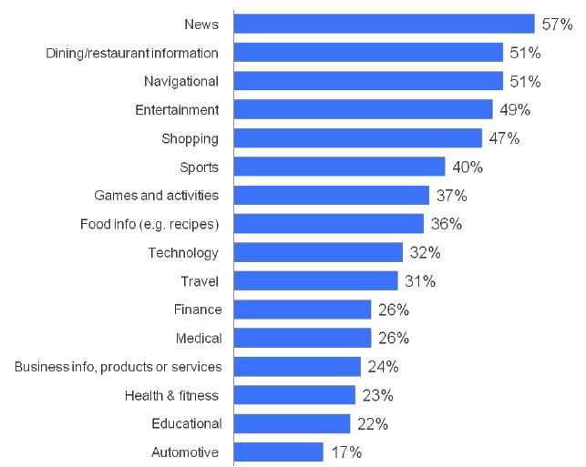
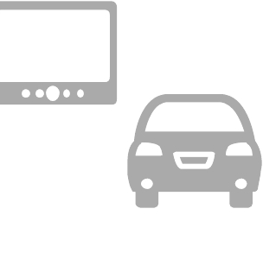
Smartphone Searchers Look For a Wide
Variety of Information
Types of Info Sought Using Search Engine (Via Smartphone)
51%
Dining
31%
Travel
49%
Entertainment
17%
Automotive
Source: The Mobile Movement Study, Google/Ipsos OTX MediaCT , Apr 2011
Base: Smartphone Users Who Use Search (4902).
Q. Which of the following types of information do you look for using a search engine on
your smartphone?
Google Confidential and Proprietary
15

Slide 17
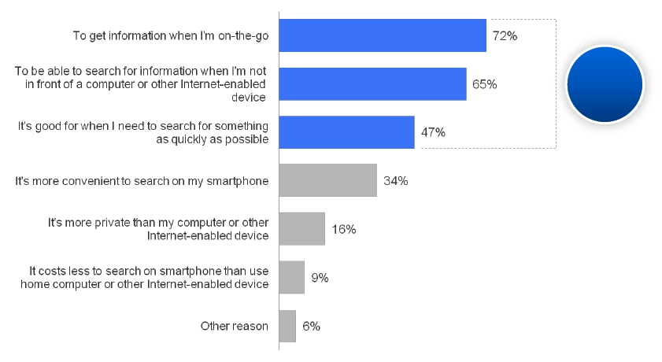
Consumers Seek Quick and Convenient
Information When Searching
Reasons For Searching On Smartphone
89%
urgency
Source: The Mobile Movement Study, Google/Ipsos OTX MediaCT , Apr 2011
Base: Smartphone Users Who Use Search (4902).
Q. Why do you conduct searches on your smartphone (versus on your computer)?
Google Confidential and Proprietary
16

Slide 18
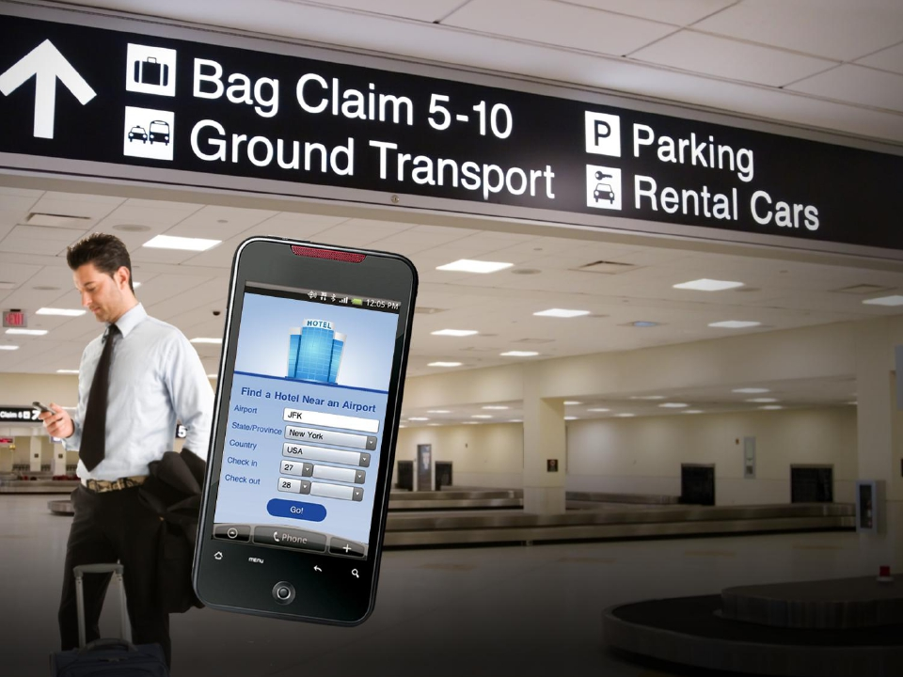
9out of10
searchers have taken
action as a result of a
smartphone search
Source: The Mobile Movement Study, Google/Ipsos OTX MediaCT , Apr 2011
Base: Smartphone Users Who Use Search (4902).
Q. Which, if any, of the following actions have you taken as a result of conducting a search on your smartphone?
Google Confidential and Proprietary
17
Google Confidential and Proprietary

Slide 19
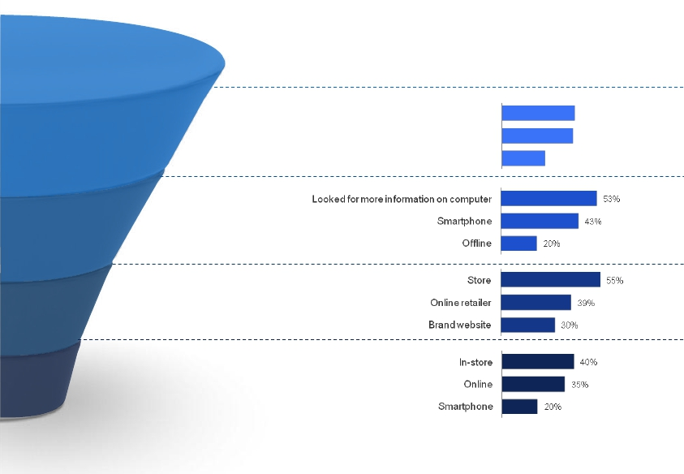
More than Half of Smartphone
Searchers Purchase
Actions Taken As a Result of a Smartphone Search
Talked to others
40%
59%
Discuss
Visited social networking
Recommended brand or product to others
39%
24%
Continue
Research
Visit a
Business
67%
68%
53% Purchase
Source: The Mobile Movement Study, Google/Ipsos OTX MediaCT , Apr 2011
Base: Smartphone Users Who Use Search (4902).
Q. Which, if any, of the following actions have you taken as a result of conducting a search on your smartphone?
Google Confidential and Proprietary
18

Slide 20
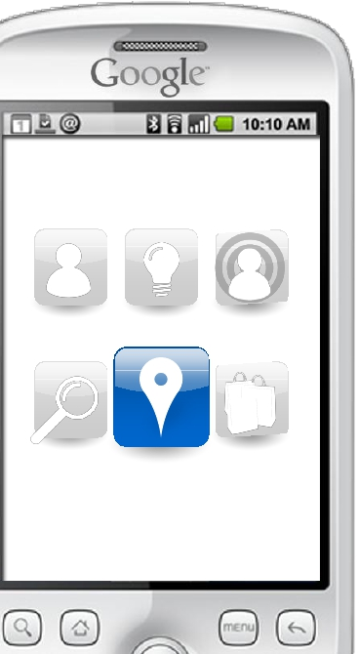
Local Information
Seekers
Google Confidential and Proprietary
19

Slide 21
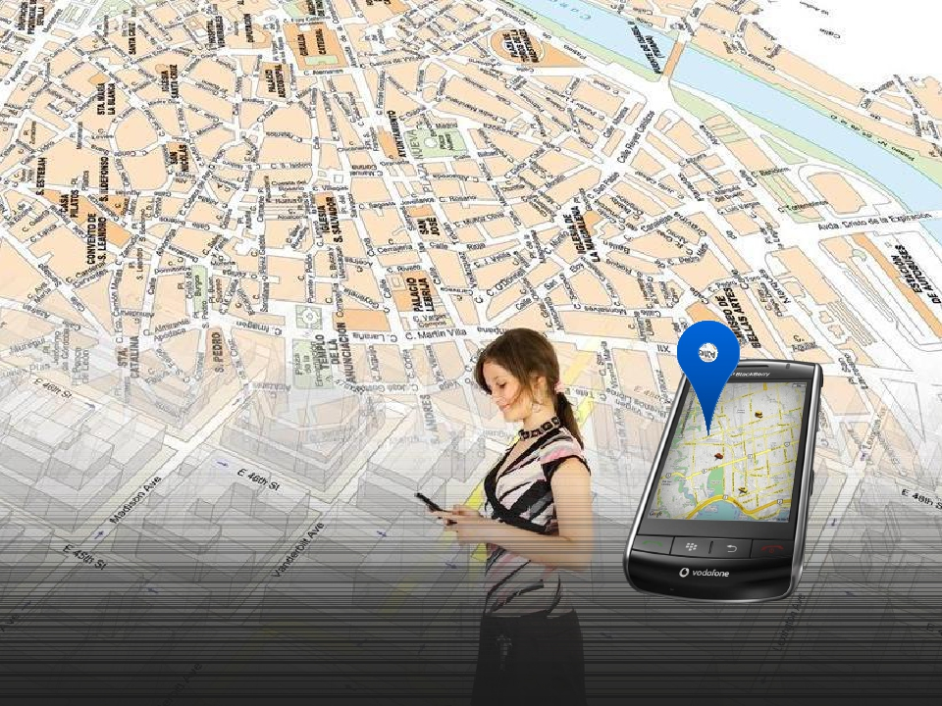
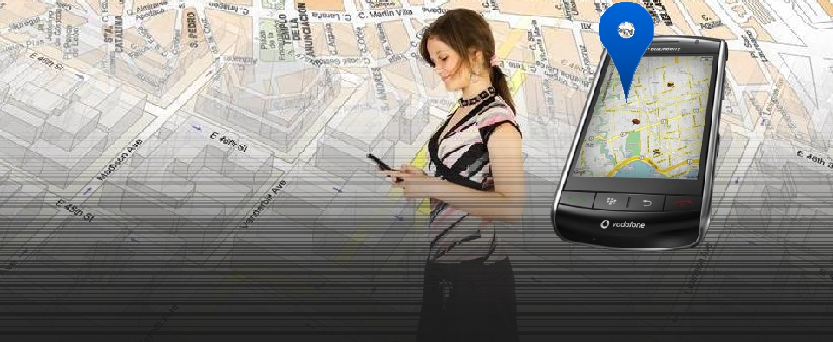
95%
Smartphone users have
looked for local information
Source: The Mobile Movement Study, Google/Ipsos OTX MediaCT , Apr 2011
Base: Smartphone Users (5013).
Q. How often do you look for information about business or services close to your location? Think about any information you
may access while you are in your home area, while traveling, etc.
Google Confidential and Proprietary
20
Google Confidential and Proprietary

Slide 22
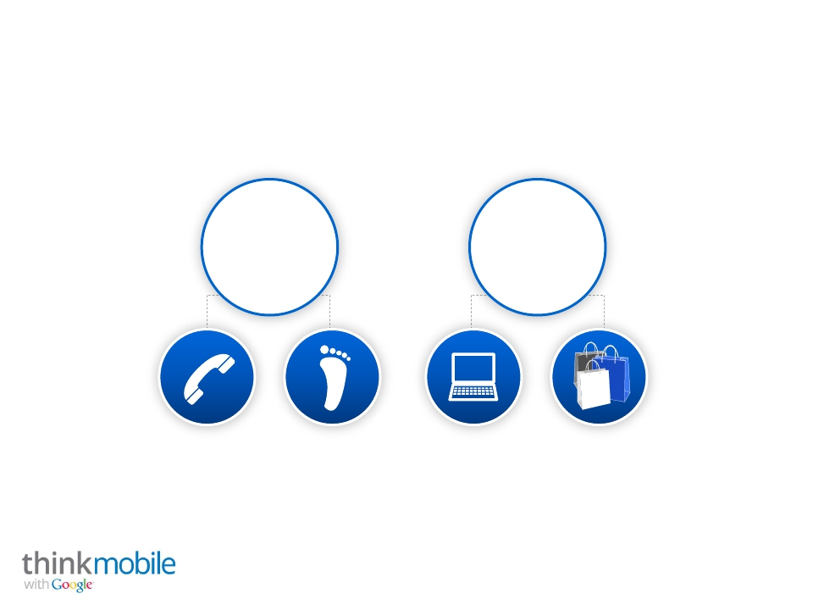
Local Information Seekers Are Ready To Buy
Actions Taken As a Result of a Looking for Local Information
77%
Contacted a business
44%
Purchased
61% Call
59% Visit
22% Online
36% Store
Source: The Mobile Movement Study, Google/Ipsos OTX MediaCT , Apr 2011
Base: Smartphone Users Who Access Local Content (4757).
Q. Which of the following actions have you taken after having looked up this type of information
(business or services close to your location) on your smartphone?
Google Confidential and Proprietary
21

Slide 23
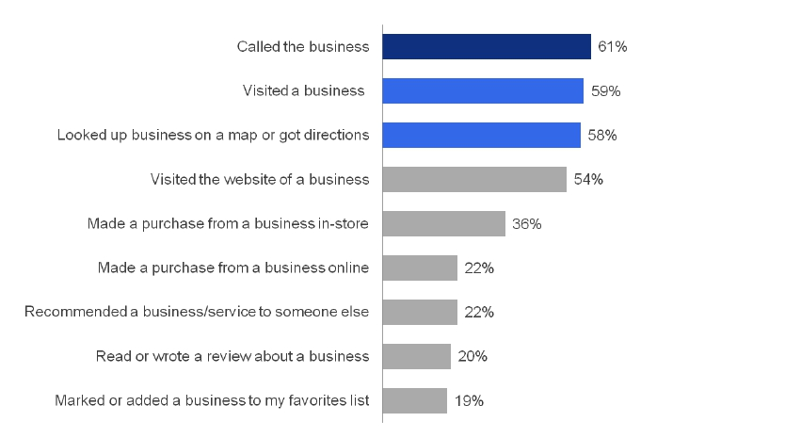
A Variety of Actions Are Taken After Accessing
Local Content
Source: The Mobile Movement Study, Google/Ipsos OTX MediaCT , Apr 2011
Base: Smartphone Users Who Access Local Content (4757).
Q. Which of the following actions have you taken after having looked up this type of information
(business or services close to your location) on your smartphone?
Google Confidential and Proprietary
22

Slide 24
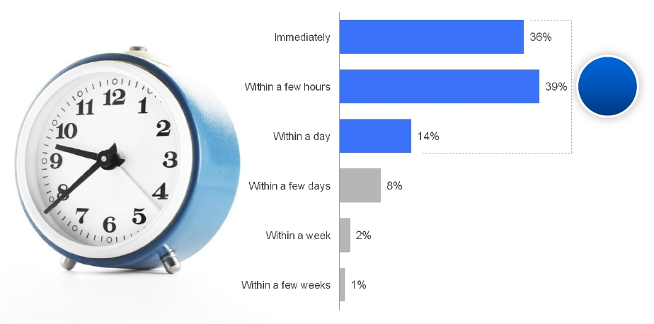
Nearly All Local Information Seekers Take
Action Within a Day
When Action Is Taken (After Looking Up Local Information)
Within
a day:
88%
Source: The Mobile Movement Study, Google/Ipsos OTX MediaCT , Apr 2011
Base: Smartphone Users Who Have Taken Action After Accessing Local Content (4330).
Q. And typically, how long after looking up local information do you take action?
Google Confidential and Proprietary
23

Slide 25
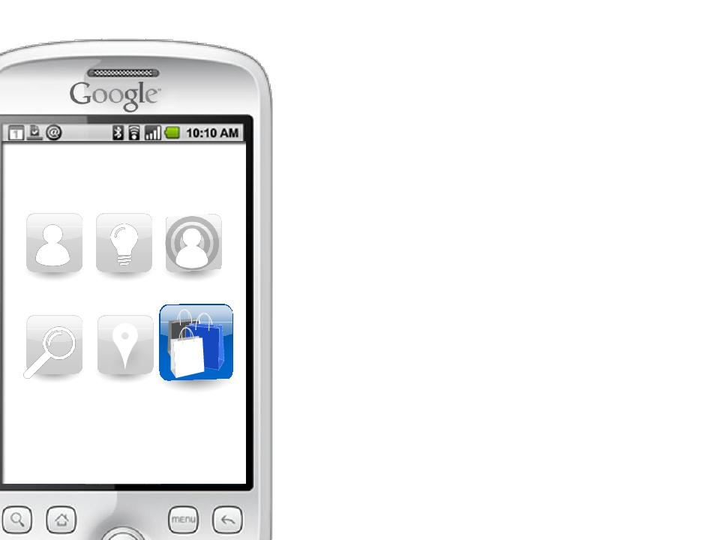
Purchase Driven
Shoppers
4
Google Confidential and Proprietary
24

Slide 26
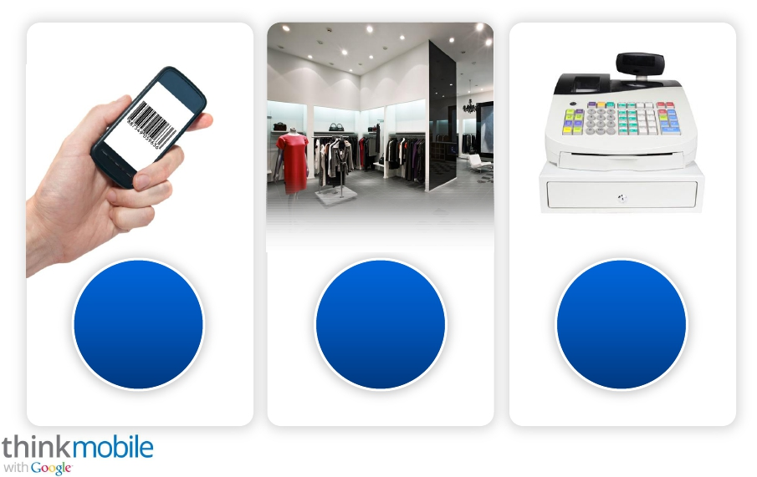
Mobile is Transforming Everyday
Shopping Behavior
74%
Of smartphone
shoppers made
a purchase as a
result of using
79%
Use phone for
shopping related
activities
70%
Use phone while
shopping in-
store
smartphone
Source: The Mobile Movement Study, Google/Ipsos OTX MediaCT , Apr 2011
Google Confidential and Proprietary
25

Slide 27
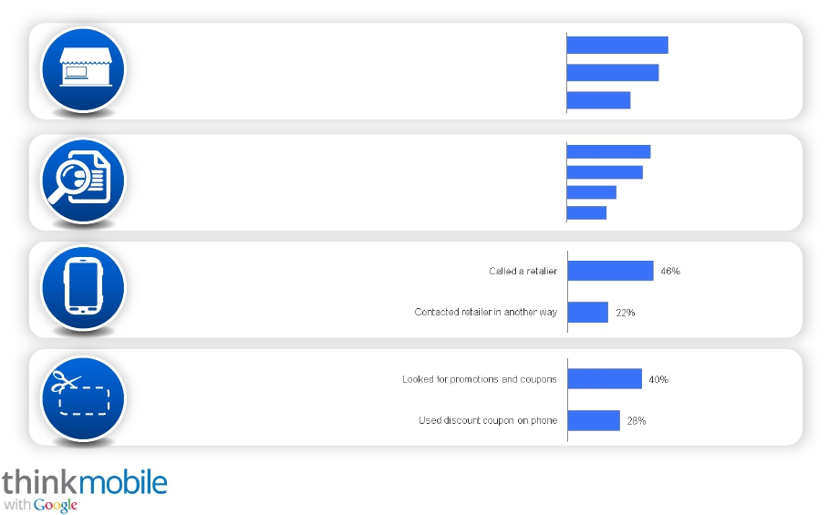
79% of Users Rely on Smartphones to Help
with Shopping
Located a retailer
54%
78% In-store Drivers
Compared prices to decide
Searched store's inventory
49%
34%
Get More
Product
Information
Read product information and reviews
Compared features of a product
Used barcode scanner
Watched online video
44%
40%
69%
26%
21%
52% Contact Retailer
Find and Use
50%
48%
Offers &
Discounts
Source: The Mobile Movement Study, Google/Ipsos OTX MediaCT , Apr 2011
Base: Smartphone Users (5013); Have Used Smartphone to Help Shop (3968).
Q. Which, if any, of the following ways have you used the Internet on your smartphone to help with
your shopping?
Google Confidential and Proprietary
26

Slide 28
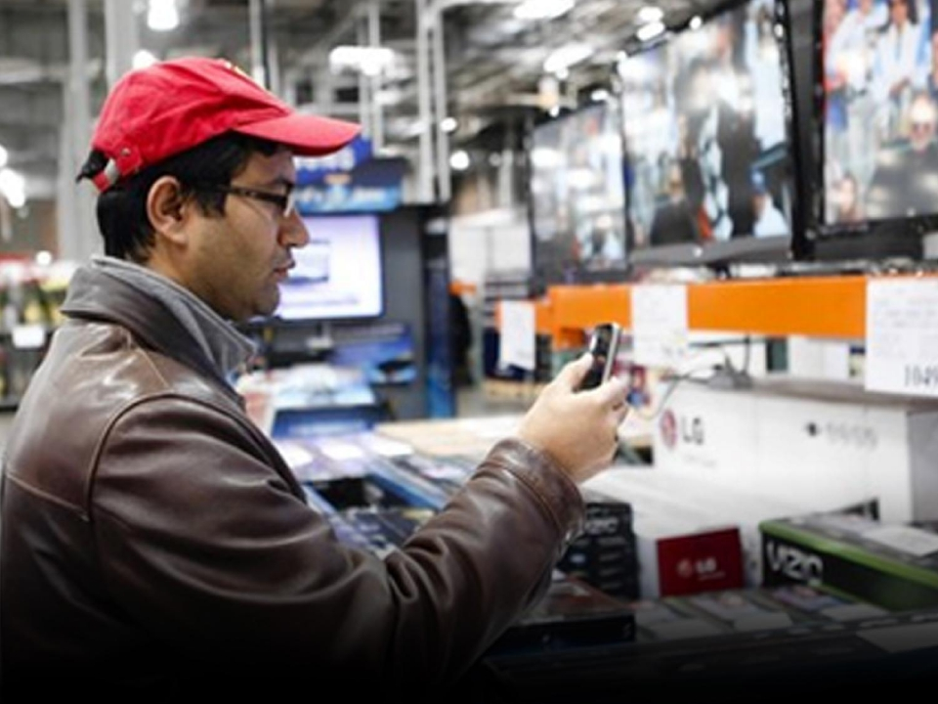
70%
Use smartphone while shopping in-store
Source: The Mobile Movement Study, Google/Ipsos OTX MediaCT , Apr 2011
Base: Have Used Smartphone to Help Shop or Purchase (4153).
Q. Have you ever used your smartphone while shopping in a store (e.g., to look up product information, prices, features)?
Google Confidential and Proprietary
27
Google Confidential and Proprietary

Slide 29
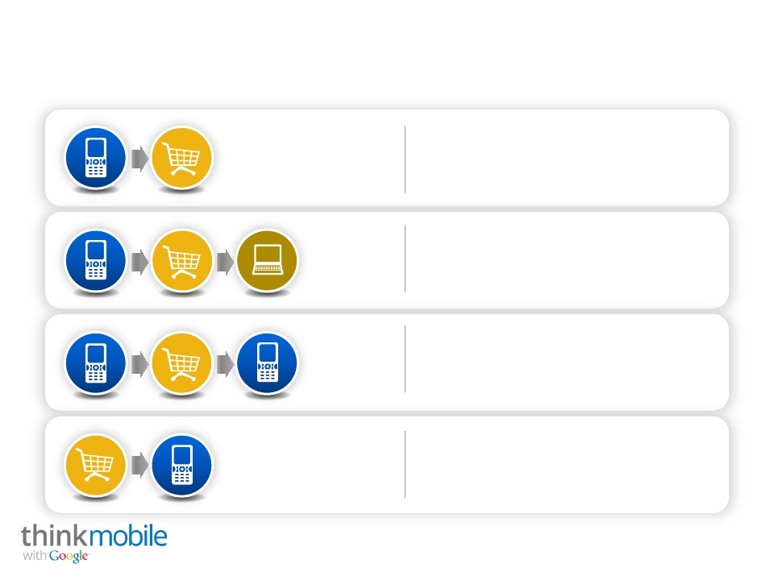
Smartphones Are an Integral Part of a
Multi-channel Purchase Process
67%
Research on smartphone and
then buy in store
Research on smartphone, visit store
$
23%
16%
9%
to check out product and then
purchase online (computer or internet
enabled device)
Research on smartphone, visit store
to check out product and then
purchase on smartphone
Visit store, then purchase on
smartphone
Source: The Mobile Movement Study, Google/Ipsos OTX MediaCT , Apr 2011
Base:
Have Used Smartphone to Help Shop or Purchase in Some Way (3533).
Q. Which of the following ways do you typically approach shopping with your smartphone?
Note: “None of these” (15%) excluded.
Google Confidential and Proprietary
28

Slide 30
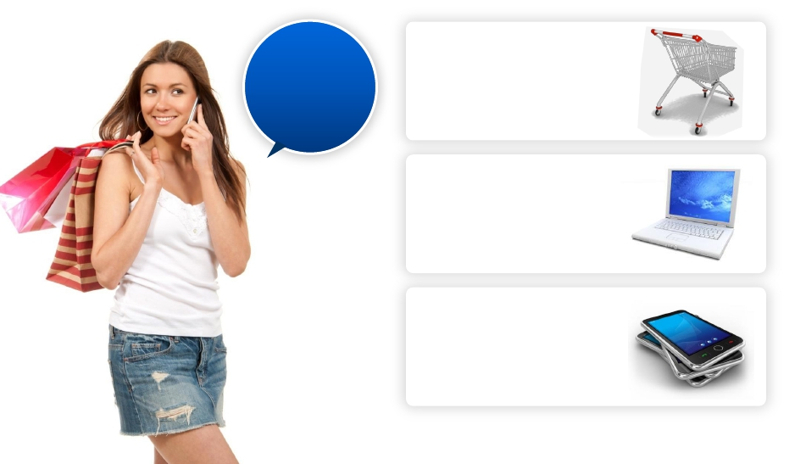
Majority of Smartphone Shoppers Purchase
Ever Made A Purchase
(As A Result Of Using A Smartphone)?
Purchase Channel
Yes
74%
Source: The Mobile Movement Study, Google/Ipsos OTX MediaCT , Apr 2011
In-store:
Online using
a computer:
Smartphone:
76%
59%
35%
Base: Smartphone Users Who Made Purchase As a Result of Using Phone While Shopping (3710).
Q.
As a result of using your smartphone have you ever purchased products or services...?
Google Confidential and Proprietary
29

Slide 31
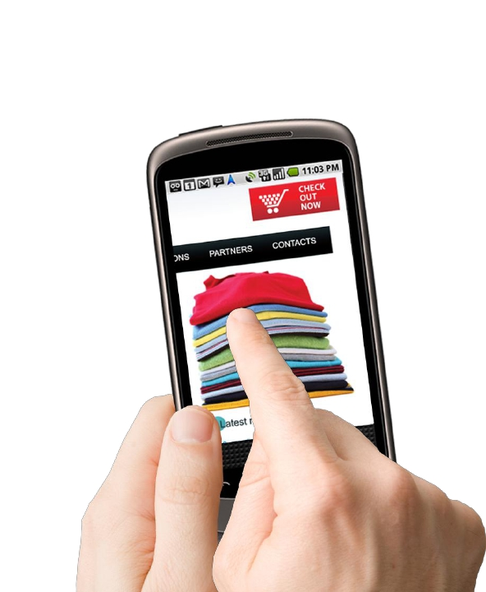
Smartphone Shoppers Purchase Via
Mobile Websites
through
website
27%
Source: The Mobile Movement Study, Google/Ipsos OTX MediaCT , Apr 2011
Base: Have Used Smartphone to Purchase (3731)
Q. As a result of using your smartphone while shopping,
have you ever purchased products or services...?
Google Confidential and Proprietary
30

Slide 32
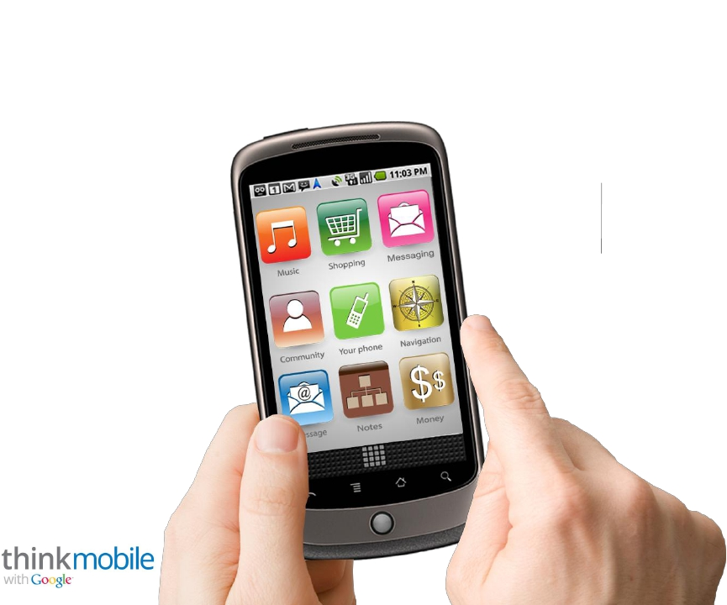
Smartphone Shoppers Purchase Via Apps
through
app
22%
Source: The Mobile Movement Study, Google/Ipsos OTX MediaCT , Apr 2011
Base: Have Used Smartphone to Purchase (3731)
Q. As a result of using your smartphone while shopping,
have you ever purchased products or services...?
Google Confidential and Proprietary
31

Slide 33
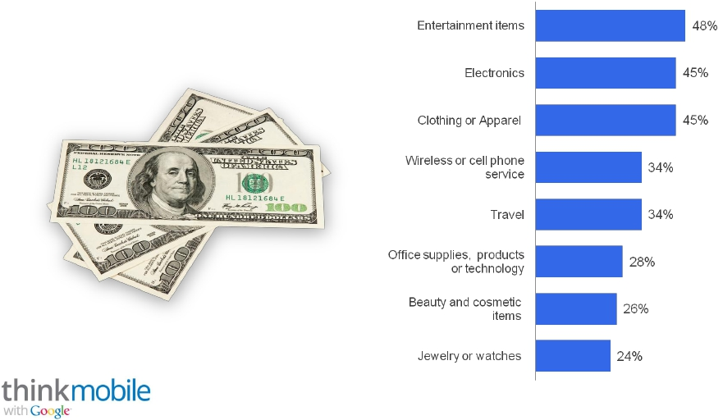
Shoppers Spent Roughly $300 On Smartphone
Purchases in Past Year
Top Purchases Made on Smartphone In Past Year
Total Amount Spent On Smartphone
Purchases (Past Year)
Median:
$300
Source: The Mobile Movement Study, Google/Ipsos OTX MediaCT , Apr 2011
Base: Purchased Products or Services on Smartphone in Past Year Through App or Website
(1255).
Q. Which of the following purchases have you made on your smartphone in the past year?
Q. And, approximately, how much have you spent in total on these purchases you have made on
your smartphone in the past year?
*Note: Exlcludes those who “Have not made a purchase in past year”.
Google Confidential and Proprietary
32

Slide 34
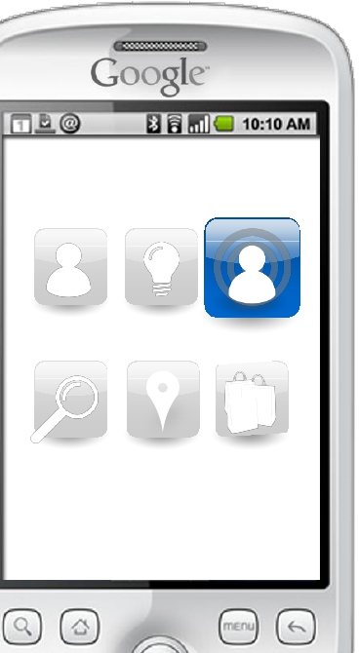
Reaching the
Mobile User
Google Confidential and Proprietary
33

Slide 35
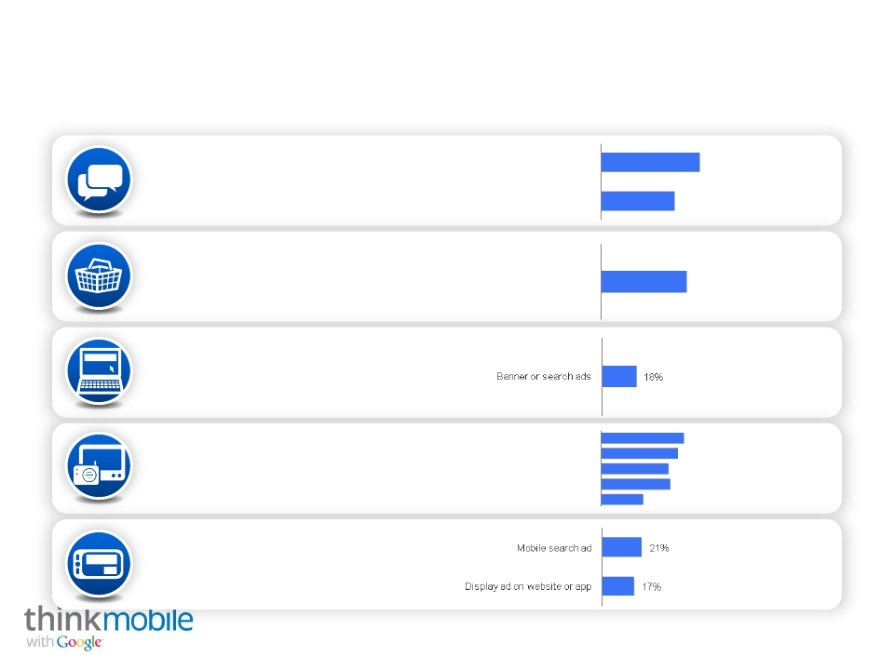
Cross Media Exposure Influences Mobile Search
Motivations for Mobile Search As a Result Of
Friends/family
51%
61%
44%
18%
68%
27%
Word of Mouth
Saw something
in Store
Saw Online
Ad
Traditional
Media
Mobile Ad
Social networking
Saw in Store
TV commercial / program
Radio
Read magazine/newspaper
Billboard
Mail
38%
44%
43%
40%
35%
36%
22%
Source: The Mobile Movement Study, Google/Ipsos OTX MediaCT , Apr 2011
Base: Smartphone Users Who Use Search (4902).
Q. Have you ever used a search engine on your smartphone to find more information
on something that you …
Google Confidential and Proprietary
34

Slide 36
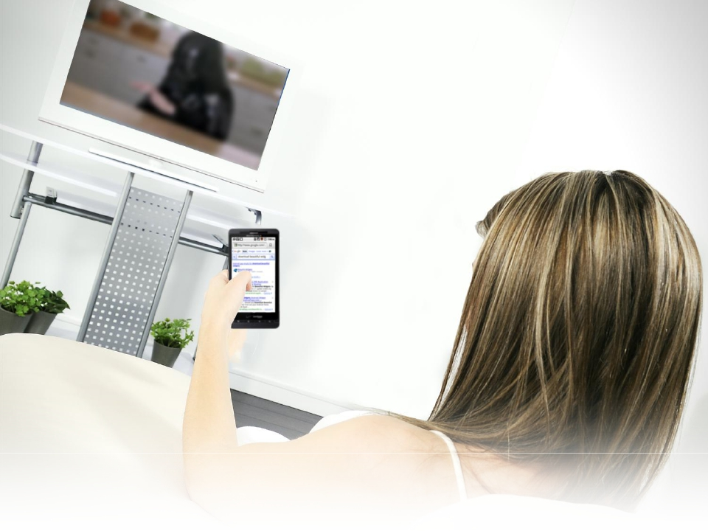
71%
search because
they saw an ad
Source: The Mobile Movement Study, Google/Ipsos OTX MediaCT , Apr 2011
Base: Smartphone Users Who Use Search (4902).
Q. Have you ever used a search engine on your smartphone to find more information on something that you …
Google Confidential and Proprietary
35
Google Confidential and Proprietary

Slide 37
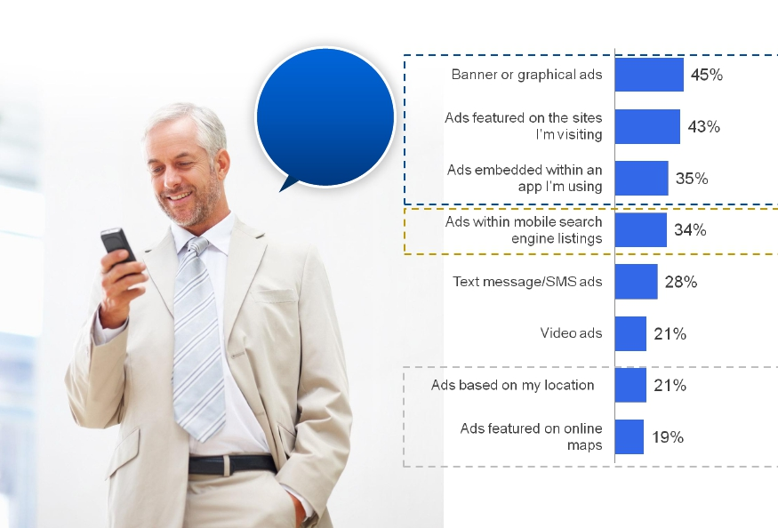
A Vast Majority Notice A Mobile Ad
Notice Ads
on Smartphone
Types of Mobile Ads Noticed
82%
Display
Ads
Search
Ads
Location/
Maps Ads
Source: The Mobile Movement Study, Google/Ipsos OTX MediaCT , Apr 2011
Base: Smartphone Users (5013)
Q.
How often do you notice advertising when you are using your smartphone?
Google Confidential and Proprietary
36

Slide 38
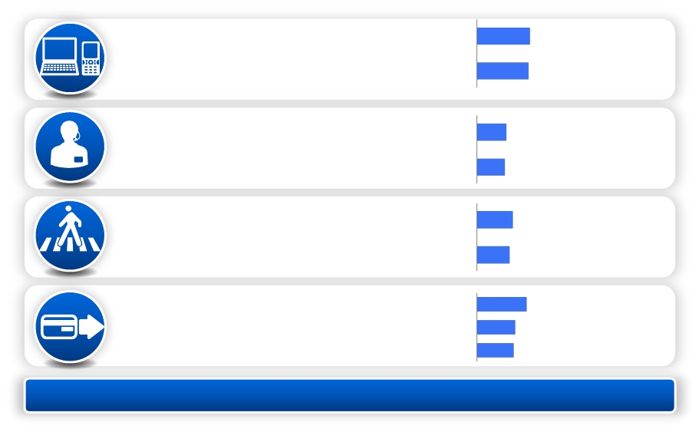
Half of Those Who See a Mobile Ad Take Action
Actions Ever Taken As a Result of Seeing A Mobile Ad
...computer
33%
49%
27%
33%
49%
Looked for More
Information
Contacted
Advertiser
Visit / Locate
Retailer
Purchase
…smartphone
Click to call advertiser on mobile
Called advertiser/retailer at later time
Went to store for additional Info
Located directions on map
Instore
Online on computer
Online with smartphone
32%
18%
17%
22%
20%
31%
24%
23%
42% Clicked on Ad | 35% Visit website
Source: The Mobile Movement Study, Google/Ipsos OTX MediaCT , Apr 2011
Base: Smartphone Users Who Took Action as a Result of Noticing Ads (1997).
Q.
Which of the following actions, if any, have you taken as a result of seeing a mobile ad of any type on your smartphone?
Google Confidential and Proprietary
37

Slide 39
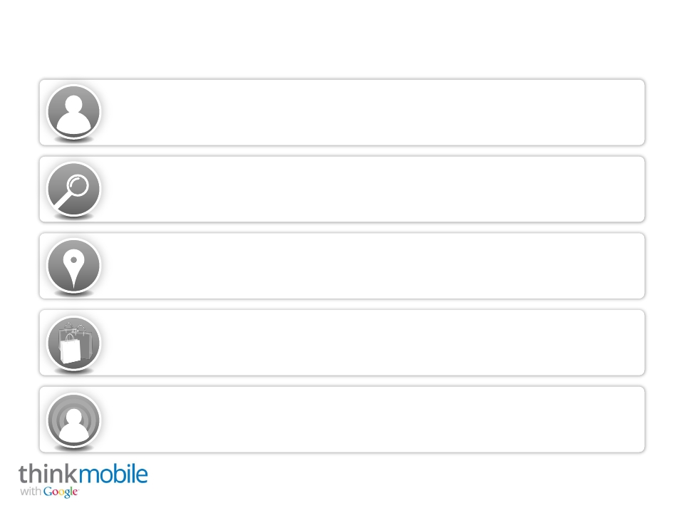
Summary of Findings and Implications
Extend online advertising strategies to mobile as consumers use their smartphones
to help with all aspects of their daily lives.
Be found via mobile search as consumers regularly use their phones to find and act on
information.
Incorporate location based products and services and make it easy for mobile
customers to reach you because local information seeking is common among
smartphone users and they are most ready to act on the information they find.
Develop a comprehensive cross-channel strategy as mobile shoppers use their
phones in-store, online and via mobile website and apps to research and make purchase
decisions. Have a mobile-optimized website so consumers can easily complete their
goals.
Implement an integrated mobile ads marketing strategy as people use their
smartphones while consuming other media and are influenced by it. Ensure your
mobile ads are engaging and appear prominently as a majority of mobile users
notice mobile ads and take action on them.
Source: The Mobile Movement Study, Google/Ipsos OTX MediaCT , Apr 2011
Google Confidential and Proprietary
38

Slide 40
Like what you learned?
Find more studies and data at
www.google.com/think/insights

